Slide 1
Medicare payments by hospital: 2015-2018
* Inpatient and Outpatient Services at US hospitals

Slide 2
Data sources:
• Medicare OP Hospital charges by APC
https://data.cms.gov/provider-summary-by-type-of-service/medicare-outpatient-hospitals/medicare-outpatient-hospitals-by-provider-and-service/data/2018
* 700K rows, 13 columns
* 78 APCs
• Medicare Inpatient Hospital charges by DRG
https://data.cms.gov/provider-summary-by-type-of-service/medicare-inpatient-hospitals/medicare-inpatient-hospitals-by-provider-and-service/data/2018
* 330K rows, 15 columns
* 550 DRGs

Slide 3
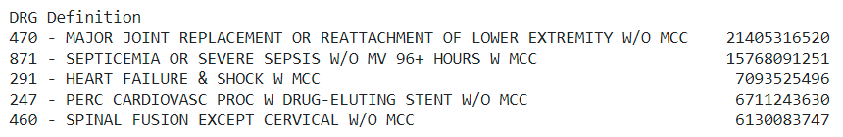
Inpatient services categorized by Diagnostic Related Group (DRG)

Slide 4
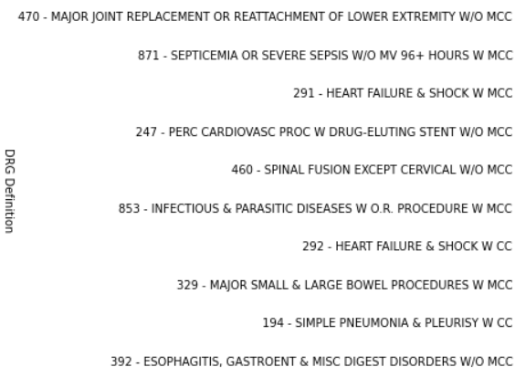
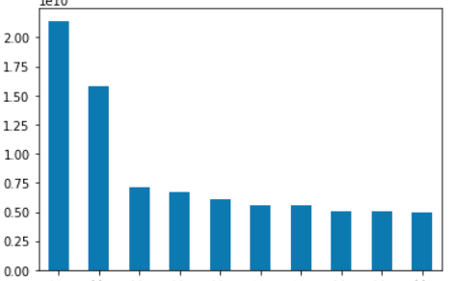
DRGs ranked by charge amount

Slide 5
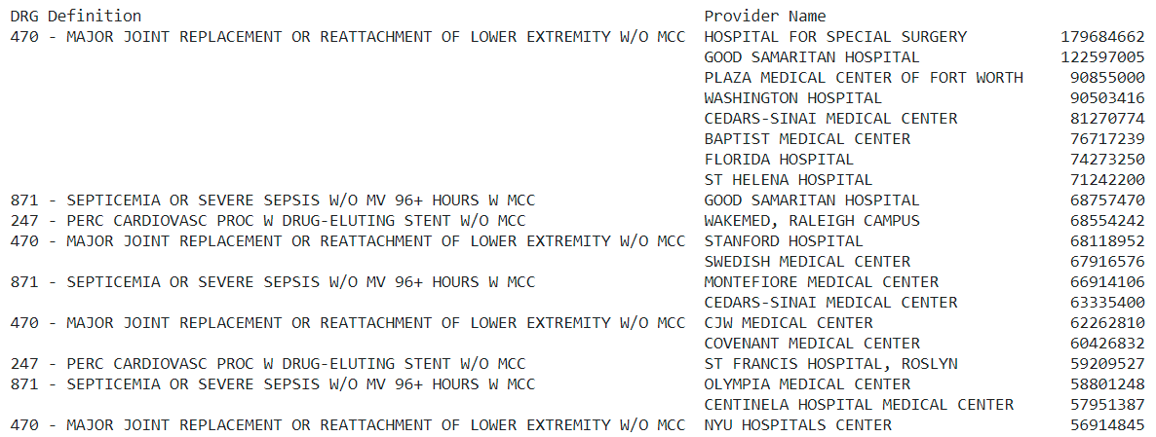
Inpatient service charges grouped by DRG-Hospital df2.groupby(['DRG Definition', 'Provider Name'])['Total Charges'].sum().sort_values(ascending=False).head(20)

Slide 6
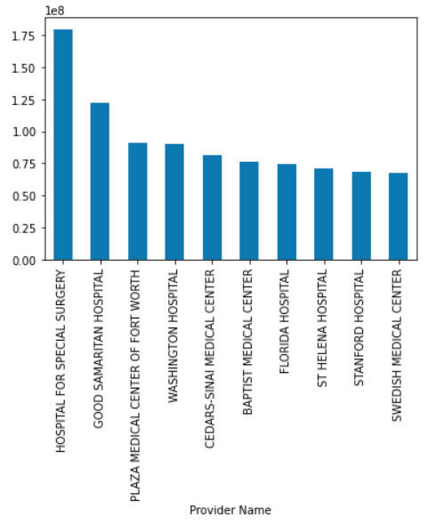
Major Joint Replacement by hospital

Slide 7
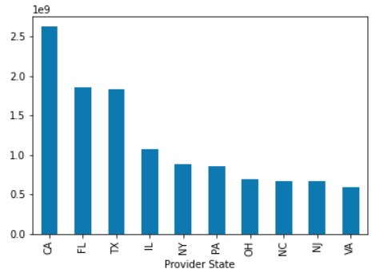
Top 10 states by inpatient hospital charges – major joint replacement

Slide 8
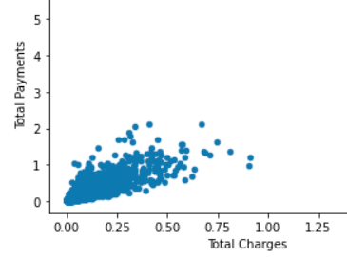
Medicare payments vs Total Inpatient Charges

Slide 9
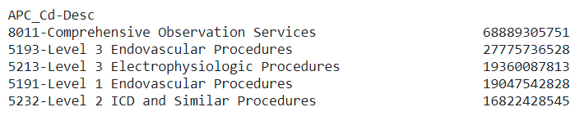
Top 5 APCs by charges, 2015-2018

Slide 10
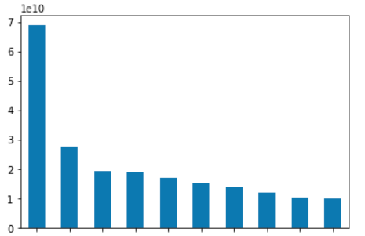
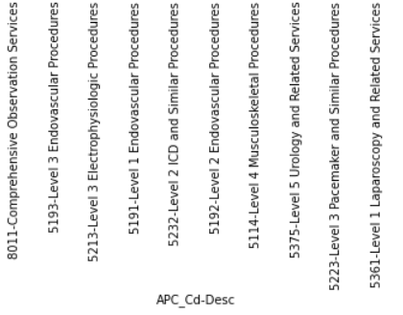
Top 10 APCs by charges, 2015-2018

